Slide 1
DIWALI SALES REPORT

Slide 2
AGENDA
Problem statement
Research Questions
Data overview
Methodology
EDA
Conclusion

Slide 3
Problem Statement
To determine which customer segments, regions and product categories contribute most to Diwali sales and use these insights to improve festive marketing and business decisions

Slide 4
Research questions
Who are the major buyers during Diwali (their gender , age and marital status)
Which state contribute most to the sales
Which occupation contribute most to the Diwali sales
Which products generates the highest revenue
What are the top 10 most sold products
How can these insights will help the company in targeted marketing and its
inventory optimization .

Slide 5
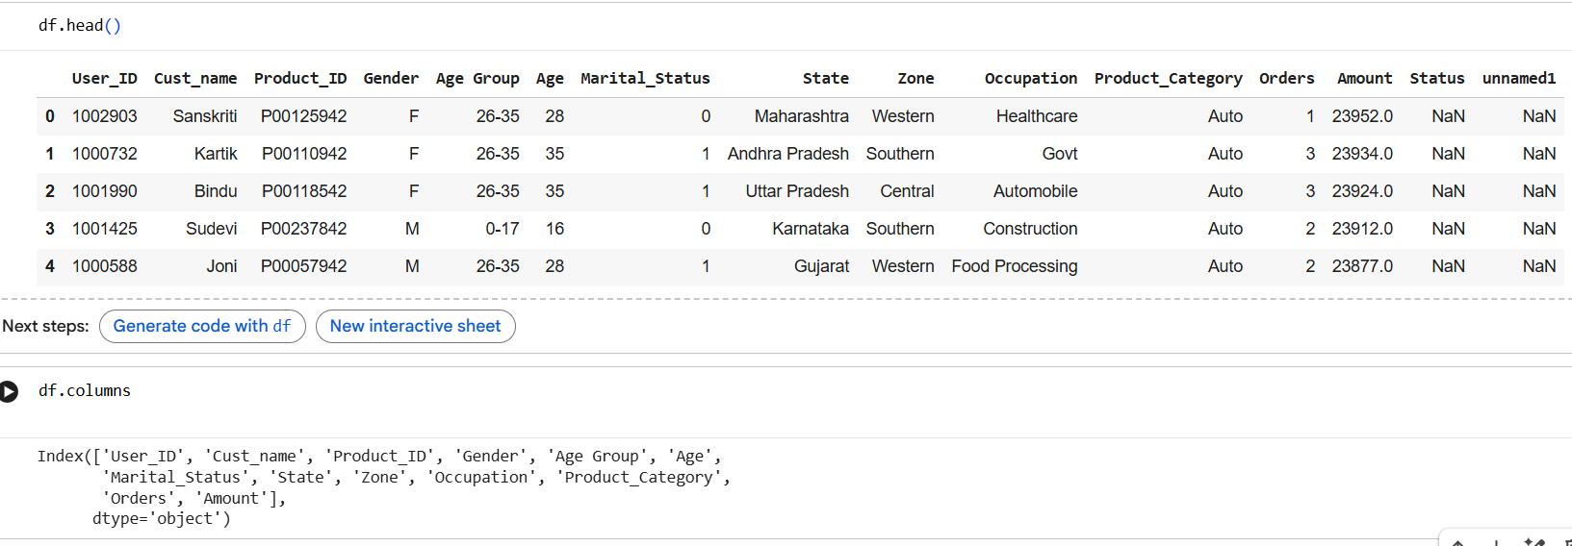
Data overview
For this analysis we have used the Diwali sales data , it consist of various columns like
'User_ID', 'Cust_name', 'Product_ID', 'Gender', 'Age Group', 'Age’, 'Marital_Status', 'State', 'Zone', 'Occupation', 'Product_Category’, 'Orders', 'Amount’ . But for this analysis we will only use relevant columns .

Slide 6
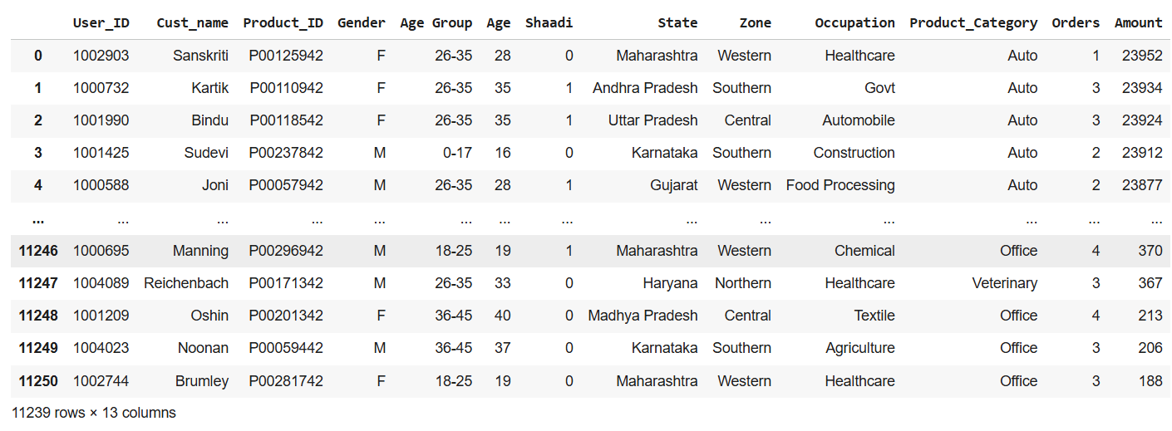
Relevant columns used for this eda
To focus only on relevant columns we have used Data cleaning procedures to concentrate only on essential columns for this analysis .
Columns we will use for this research are 'User_ID', 'Cust_name', 'Product_ID', 'Gender', 'Age Group', 'Age’, 'Marital_Status', 'State', 'Zone', 'Occupation', 'Product_Category’, 'Orders', 'Amount’ .

Slide 7
Methodology
1. Data loading
Loaded Diwali Sales dataset using Pandas for analysis.
2. Data Inspection
Reviewed structure, data types, and basic statistics of the dataset.
3. Data Cleaning
Removed irrelevant columns , changed column name(marital status -> shaadi) and removed
null values
4. Exploratory Data Analysis (EDA)
Used visualizations to study customer behavior, pattern of sales and category trends.
5. Insight Generation
Identified top customer , top states, and best performing product categories.
6. Conclusion
Concluded which age group from which state and profession is contributing more to which
product

Slide 8
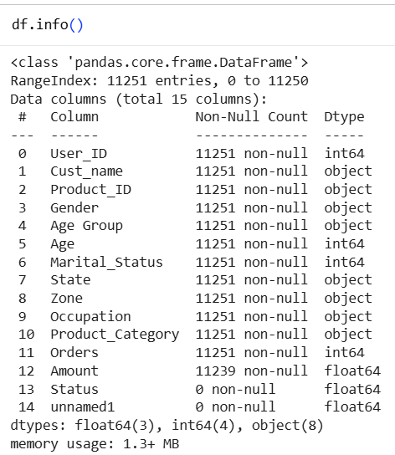
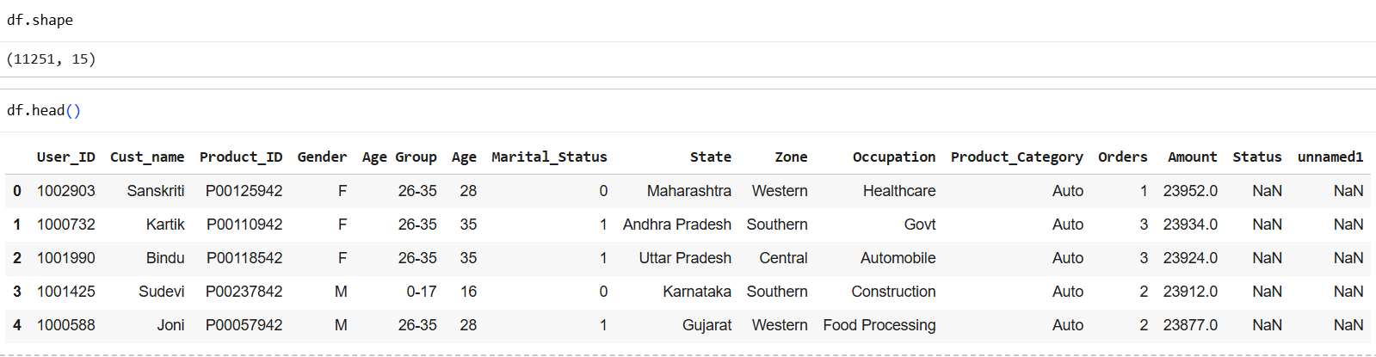
Journey insights
Understanding the raw dataset :
The process began by exploring the structure of the dataset using
shape, head, and info. This will help us to identify unnecessary
columns , their datatypes , missing values (null values) , number of
rows and columns in a dataset .

Slide 9
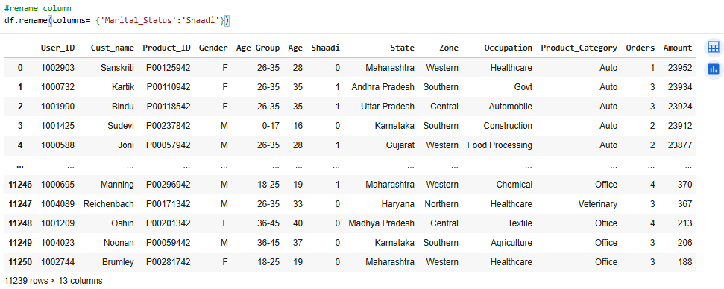
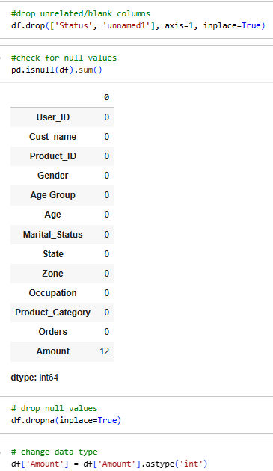
Cleaning and preparing the data :
Irrelevant columns like 'Status', 'unnamed1’ were removed , Null
values from Amount column is also removed , datatype of
Amount column is changed to int64 from float64 , renamed
the 'Marital_Status’ column to 'Shaadi’ . Now out dataset is
ready for analysis .

Slide 10
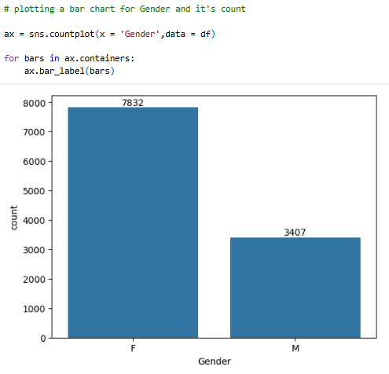
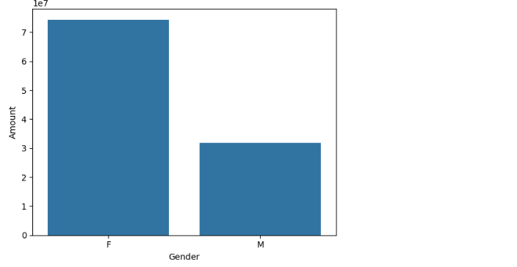
Exploratory data analysis (eda)
Plotting a bar chart for gender and its count and Gender VS total amount to understand which gender is contributing more and who have more purchasing power .
* From above graphs we can see that most of the buyers are females and even the purchasing
power of females are greater than men

Slide 11
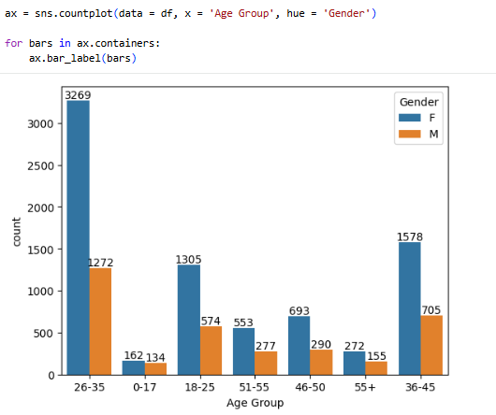
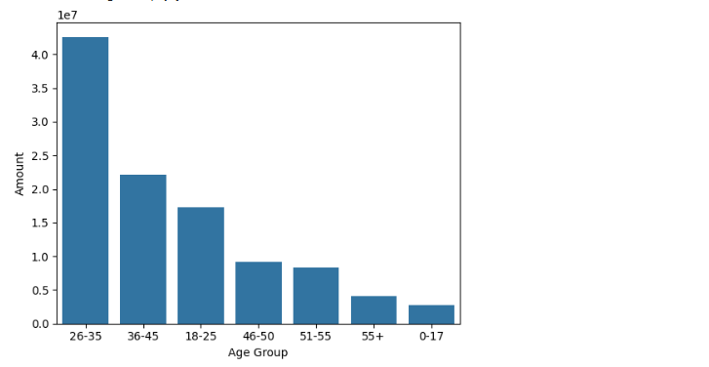
Now using a count plot to examine which age group has the highest number of buyers and how purchasing frequency differ between male and female After this a bar plot for total amount VS age group is plotted to understand which age group from which gender is contributing most to revenue . These visualization will reveal which is most active and highest spending customer segment .
* From above graphs we can see that most of the buyers are of age group between 26-35 yrs
female

Slide 12
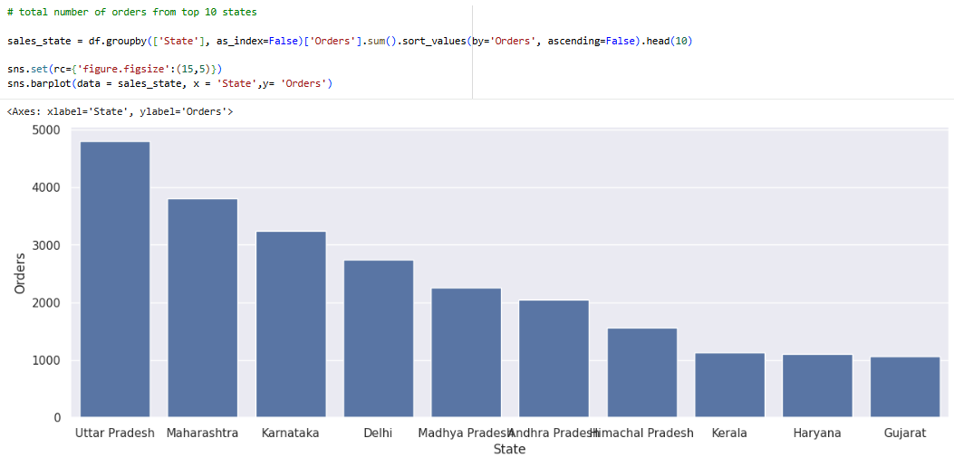
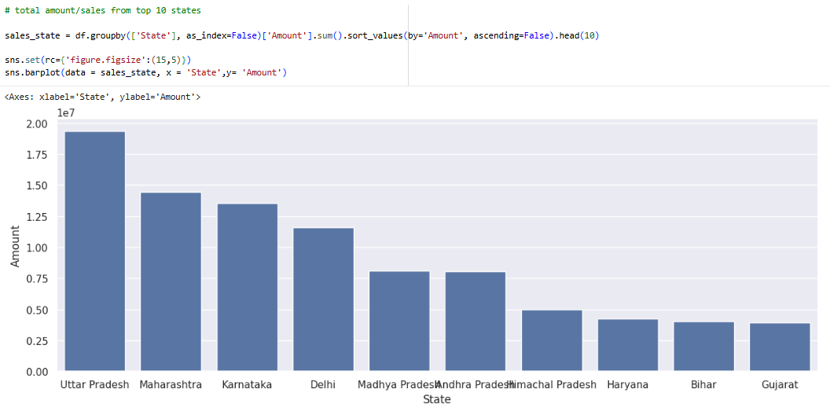
Analysing the top 10 states with highest number of orders , then analysing top 10 states generating the highest total revenue . Together this analysis will reveal which region is contributing most to Diwali sales .
* From above graphs we can see that most of the orders & total sales/amount are from Uttar Pradesh, Maharashtra and Karnataka respectively

Slide 13
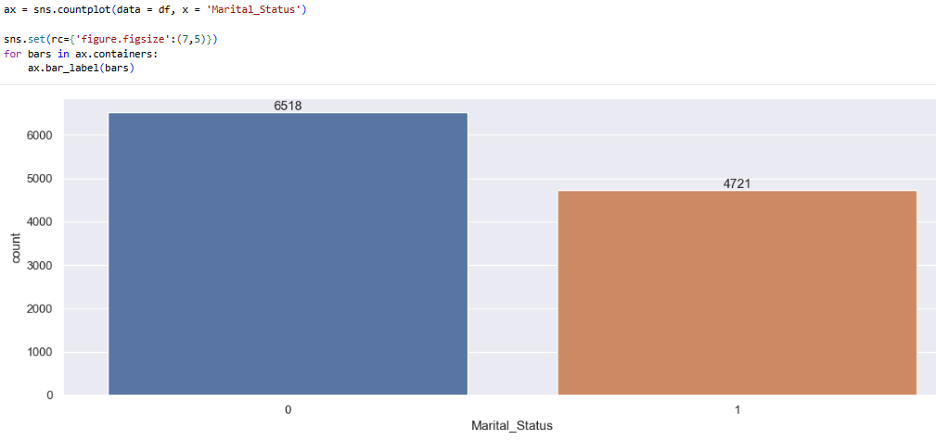
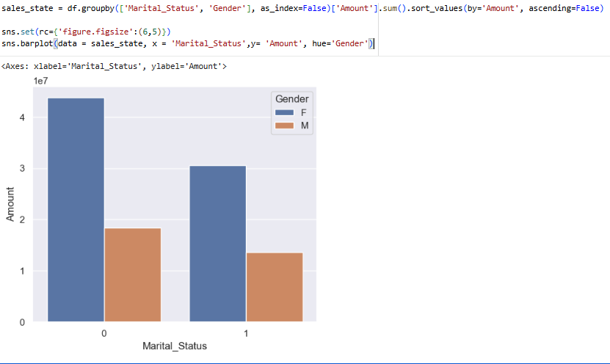
Analysing which marital group places more orders and then identifying which gender marital segment is contributing the highest .
* From above graphs we can see that most of the buyers are married (women) and they have high purchasing power .

Slide 14
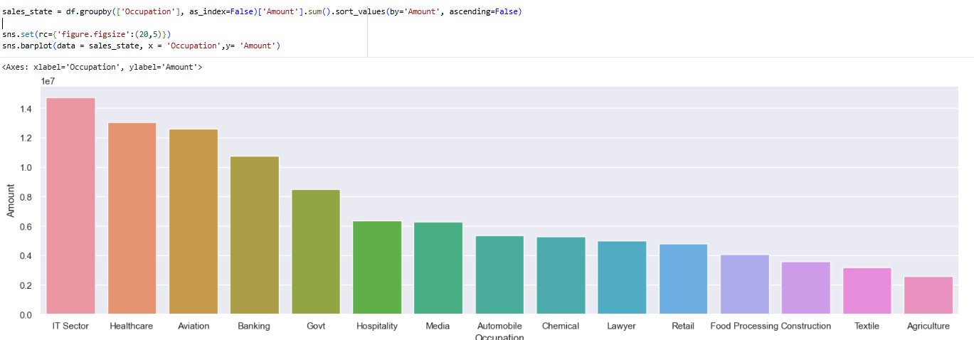
Examining which occupation is generating most number of orders then analysing total revenue contribution by each occupation . This will help us to understand which is high value and high engagement customer segments .
* From above graphs we can see that most of the buyers are working in IT, Healthcare and Aviation sector .

Slide 15
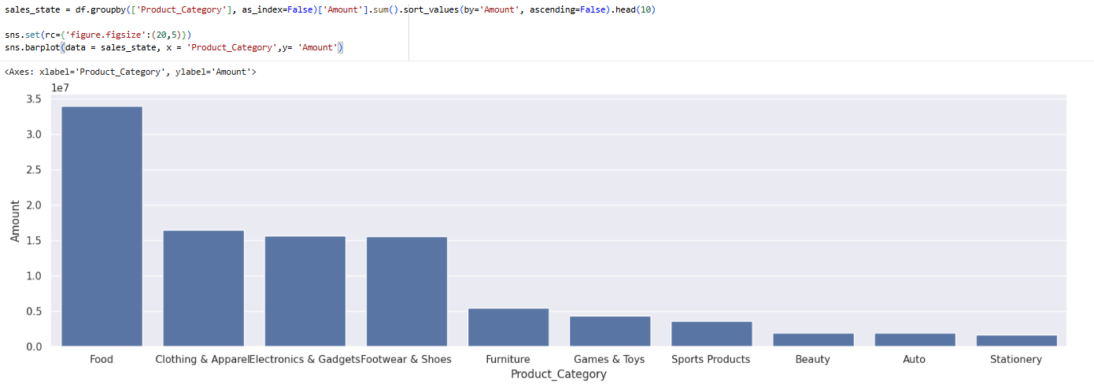
Analysing how many orders came from each product category and then which product category generated highest revenue . This helps understand both customer preferences and high-earning product segments .
* From above graphs we can see that most of the sold products are from Food, Clothing and Electronics category

Slide 16
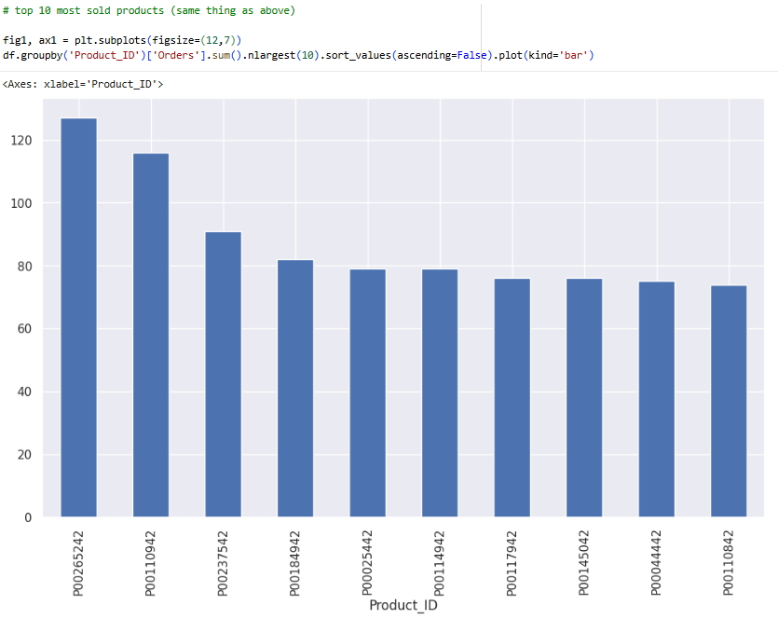
Examining which items were most in demand during Diwali , this will help in planning stock and marketing.

Slide 17
Conclusion
The highest sales came from married women aged 26–35, mainly from Uttar Pradesh, Maharashtra, and Karnataka. Most of them worked in IT, Healthcare, or Aviation and preferred buying products from the Food, Clothing, and Electronics categories.

